Slide 1

Longitudinal Bioelectrical Impedance Analysis Distinguishes Cognitive Stability from Early Transition to Mild Cognitive Impairment in Older Adults
Lab Meeting
2025.11.20
Notes:
This week, I will continue presenting the next steps in the LME model

Slide 2
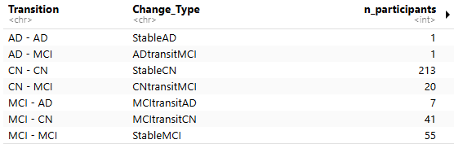
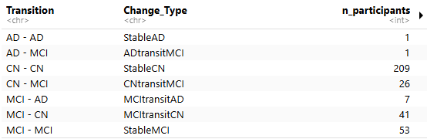
Dataprocessing
Original
+ intermediate converters (6 subjects)
- excluded subjects with <11 months follow-up
Modified
Notes:
Building upon last week’s idea, from nearly 350 participants, we continue to focus our research on two groups: StableCN and CNtransitMCI. After including 6 additional subjects and excluding those who participated for less than 11 months, we now have two groups with sample sizes of 209 and 26, respectively

Slide 3
Table 1: Baseline Demographics & Cognition
Variable | StableCN (n=209) | CNtransitMCI (n=26) | P-value | SMD
Sex (M) | 88 (42.1%) | 16 (61.5%) | 0.095 | ---
Age (mean ± SD) | 71.2 ± 4.47 | 72.6 ± 4.71 | 0.191 | -0.31
Education (yrs) | 12.2 ± 4.49 | 14.4 ± 3.75 | 0.014 | -0.50
GDS | 7.7 ± 6.65 | 5.8 ± 6.18 | 0.113 | 0.29
MMSE | 27.9 ± 1.68 | 27.6 ± 2.02 | 0.609 | 0.18
SNSB-Attention | 9.8 ± 2.10 | 9.8 ± 2.42 | 0.589 | 0.02
SNSB-Memory | 0.69 ± 4.62 | 0.16 ± 0.51 | 0.055 | 0.12
Notes:
I first performed the Shapiro test, and then selected either the t-test or the U-test for each continuous variable, and the Chi-squared test for the categorical variables.
Most baseline variables show no significant difference, but education years are higher in the CNtransitMCI group (P=0.014, SMD=-0.5).

Slide 4
Table 2: Anthropometry and whole-body composition in 2 groups upon controlling for age, sex & education in baseline.
Variable | Unit | StableCN_AdjMean_CI | CNtransitMCI_AdjMean_CI | Diff_CI | SE | PValue
height | cm | 160.06 (159.35, 160.76) | 162.39 (160.38, 164.40) | -2.33 (-4.46, -0.19) | 1.08 | 0.0328
weight | kg | 62.87 (61.81, 63.93) | 63.80 (60.78, 66.83) | -0.93 (-4.15, 2.28) | 1.63 | 0.5682
bmi | kg/m2 | 24.51 (24.07, 24.95) | 24.25 (22.99, 25.50) | 0.26 (-1.07, 1.60) | 0.68 | 0.6975
ac | cm | 30.10 (29.79, 30.41) | 30.15 (29.26, 31.04) | -0.05 (-0.99, 0.90) | 0.48 | 0.9238
whr |  | 0.89 (0.88, 0.89) | 0.90 (0.87, 0.92) | -0.01 (-0.03, 0.01) | 0.01 | 0.352
pbcm | % | 43.47 (42.95, 44.00) | 44.28 (42.79, 45.77) | -0.81 (-2.39, 0.77) | 0.8 | 0.3146
pbf | % | 32.41 (31.61, 33.22) | 31.22 (28.93, 33.52) | 1.19 (-1.25, 3.63) | 1.24 | 0.3371
bmr | kcal | 1287.27 (1275.11, 1299.43) | 1316.53 (1281.88, 1351.17) | -29.26 (-66.07, 7.56) | 18.69 | 0.1187
tbw_ffm | % | 0.74 (0.74, 0.74) | 0.74 (0.74, 0.74) | -0.00 (-0.00, 0.00) | 0 | 0.9015
ecw_tcw | % | 0.39 (0.39, 0.39) | 0.39 (0.39, 0.39) | 0.00 (-0.00, 0.00) | 0 | 0.6862
PA50 | degree | 5.13 (5.06, 5.20) | 5.20 (5.00, 5.40) | -0.07 (-0.28, 0.15) | 0.11 | 0.5477
Notes:
Next, I used ANCOVA to evaluate the BIA variables between the two groups upon controlling for age, sex, education & GDS score, as shown in Tables 2 and 3. No major differences, though CNtransitMCI slightly taller on average (P=0.033).

Slide 5
Table 3: Segmental bioimpedance variables in 2 groups upon
controlling for age, sex, education & GDS score in baseline
Variable | Unit | StableCN_AdjMean_CI | CNtransitMCI_AdjMean_CI | Diff_CI | SE | PValue
ECW_ICW_upper | % | 0.61 (0.61, 0.61) | 0.61 (0.61, 0.61) | 0.00 (-0.00, 0.01) | 0 | 0.3924
ECW_ICW_lower | % | 0.66 (0.65, 0.66) | 0.66 (0.65, 0.67) | 0.00 (-0.01, 0.01) | 0 | 0.8244
Water_Lean_upper | % | 0.78 (0.78, 0.78) | 0.78 (0.78, 0.78) | 0.00 (-0.00, 0.00) | 0 | 0.0555
Water_Lean_lower | % | 0.78 (0.78, 0.78) | 0.78 (0.78, 0.78) | 0.00 (-0.00, 0.00) | 0 | 0.7021
R_upper | Ohm | 328.58 (324.25, 332.90) | 325.78 (313.45, 338.11) | 2.79 (-10.31, 15.90) | 6.65 | 0.6749
R_lower | Ohm | 233.91 (230.17, 237.64) | 238.52 (227.88, 249.16) | -4.61 (-15.92, 6.69) | 5.74 | 0.4223
Xc_upper | Ohm | 29.74 (29.28, 30.20) | 30.13 (28.83, 31.44) | -0.39 (-1.78, 0.99) | 0.7 | 0.5766
Xc_lower | Ohm | 20.02 (19.52, 20.51) | 20.54 (19.14, 21.95) | -0.53 (-2.02, 0.97) | 0.76 | 0.4884
PA_upper | degree | 5.24 (5.18, 5.31) | 5.34 (5.15, 5.53) | -0.10 (-0.30, 0.11) | 0.1 | 0.3459
PA_lower | degree | 4.95 (4.84, 5.05) | 4.97 (4.67, 5.27) | -0.03 (-0.35, 0.29) | 0.16 | 0.8725
R_H_upper | Ohm | 2.07 (2.04, 2.10) | 2.02 (1.94, 2.10) | 0.05 (-0.04, 0.14) | 0.04 | 0.2787
R_H_lower | Ohm | 1.47 (1.44, 1.49) | 1.48 (1.41, 1.55) | -0.01 (-0.08, 0.07) | 0.04 | 0.8431
Xc_H_upper | Ohm | 0.19 (0.18, 0.19) | 0.19 (0.18, 0.20) | 0.00 (-0.01, 0.01) | 0 | 0.9685
Xc_H_lower | Ohm | 0.13 (0.12, 0.13) | 0.13 (0.12, 0.14) | -0.00 (-0.01, 0.01) | 0 | 0.7536
Notes:
Segmental bioimpedance values are very similar between groups at baseline. No significant group differences detected.

Slide 6
LME Methods Overview
Linear Mixed-Effects Modeling
Model specification: BIAmarker ~ elapsed_years × groups + AGE + SEX + EDUYR + (1 + elapsed_years | USUBJID)
Fitted using lmerTest::lmer() for all bioimpedance/cognitive markers
Random intercepts + random slopes per subject to capture individual heterogeneity
Statistical Inference Strategy
Primary test: Likelihood Ratio Test (LRT) comparing full vs reduced models (no interaction term)
Secondary: Wald test for interaction coefficients (descriptive)
Effect size: Cohen's d from standardized slope differences
Reporting: Annual slopes per group, 95% CI, both LRT and Wald p-values
Model Diagnostics
Residual diagnostics: QQ plots and fitted vs residuals checked
AIC (Akaike Information Criterion) & BIC (Bayesian Information Criterion), marginal/conditional R² reported in full analysis

Slide 7
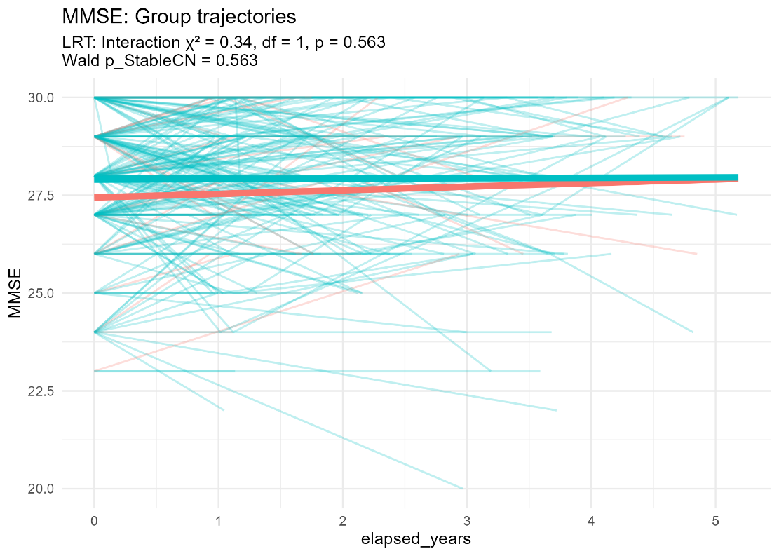
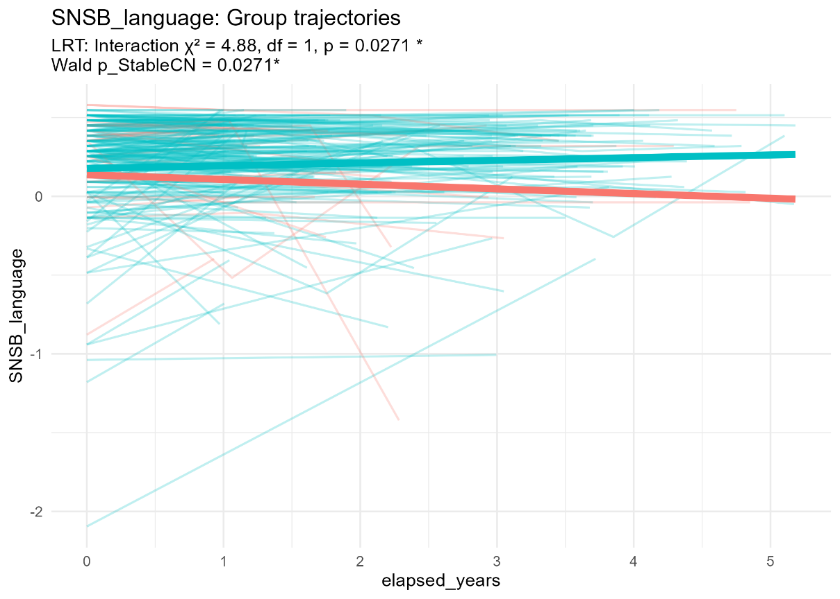
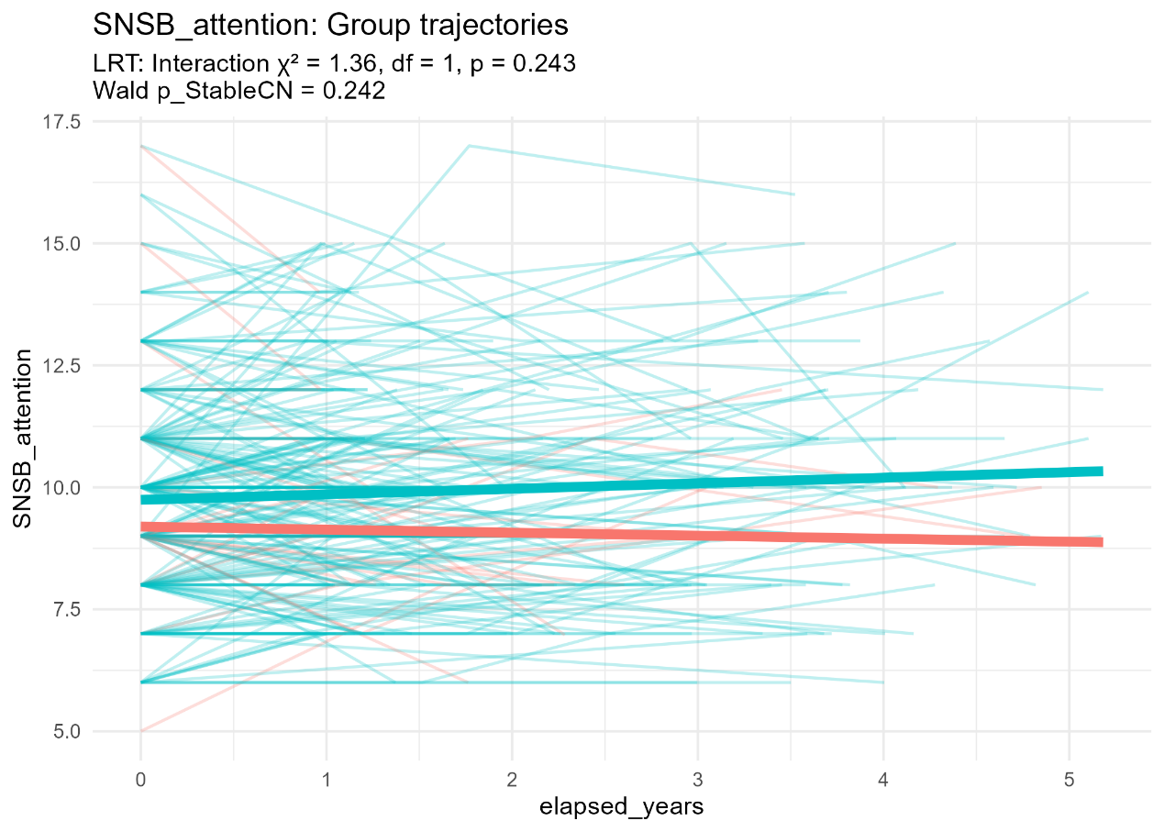
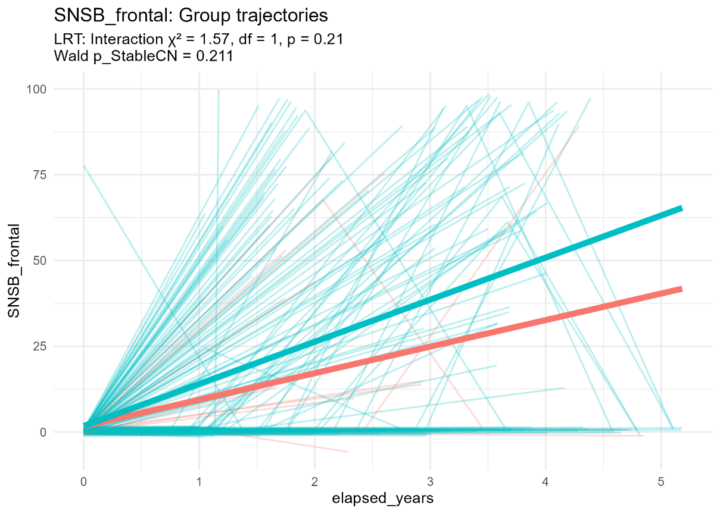
Linear Mixed-Effects Modeling
Notes:
Group Trajectories: SNSB-Language: Slight divergence (LRT p=0.027, d=0.25)

Slide 8
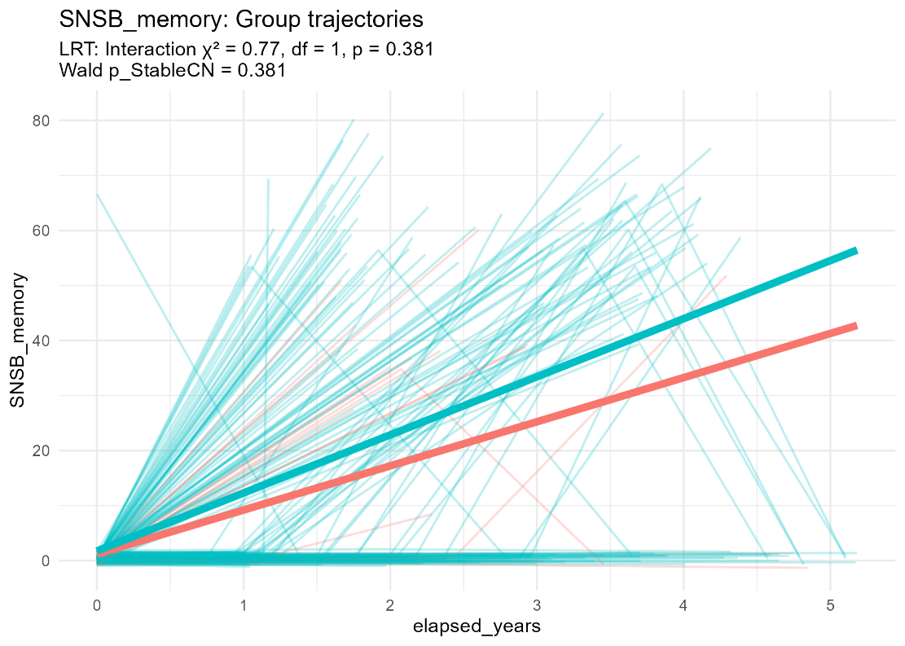
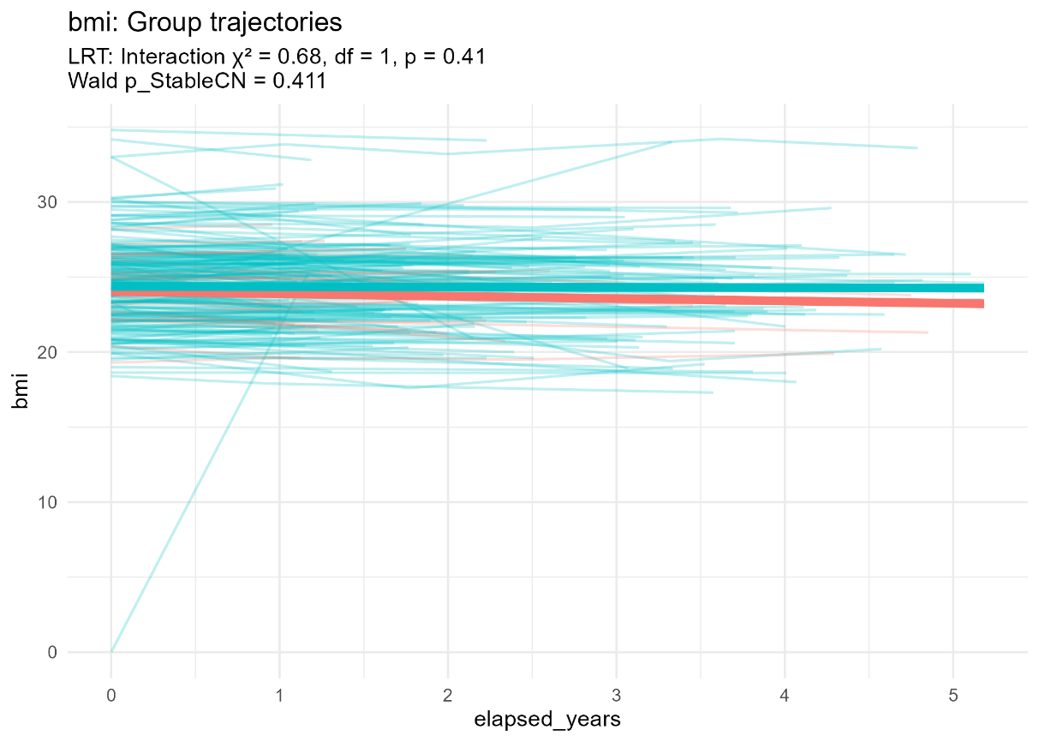
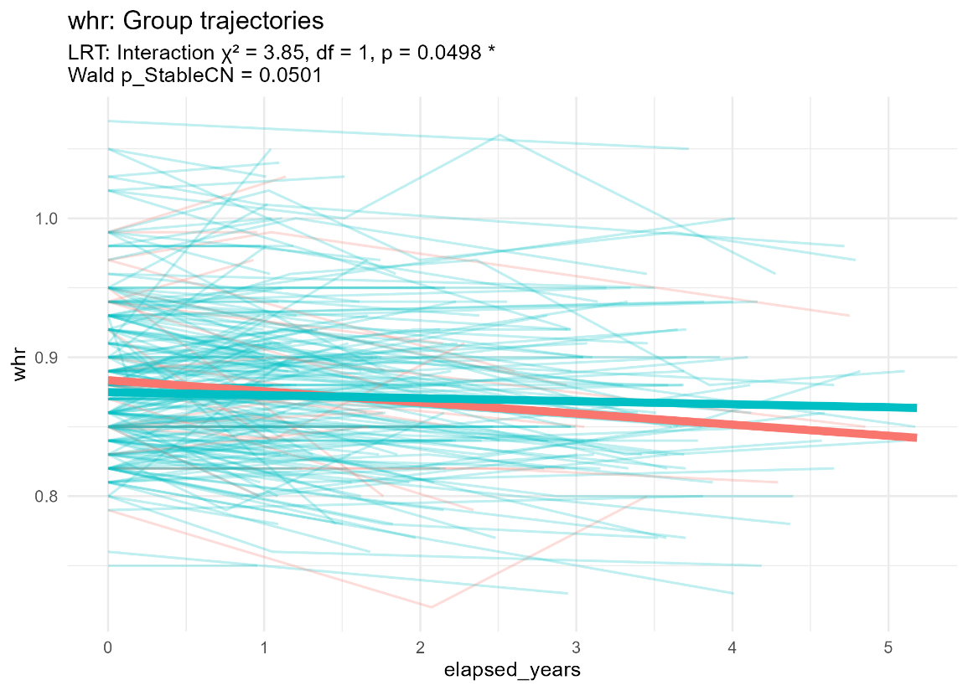
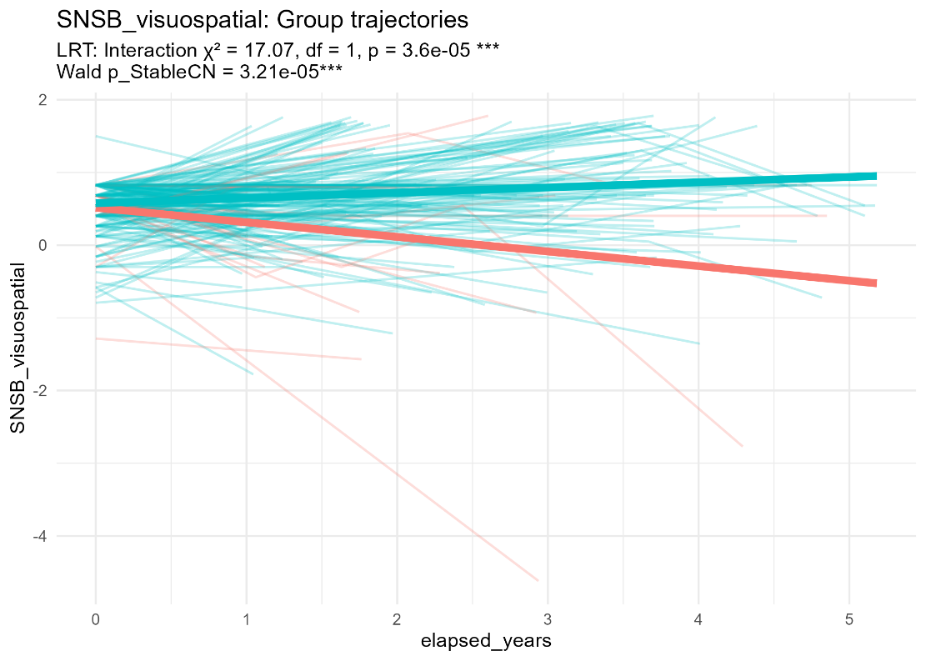
Linear Mixed-Effects Modeling
Notes:
Most Significant Divergence is SNSB-Visuospatial with p<0.001. whr is only one BIA has siginificat change with p < 0.05 in LRT

Slide 9
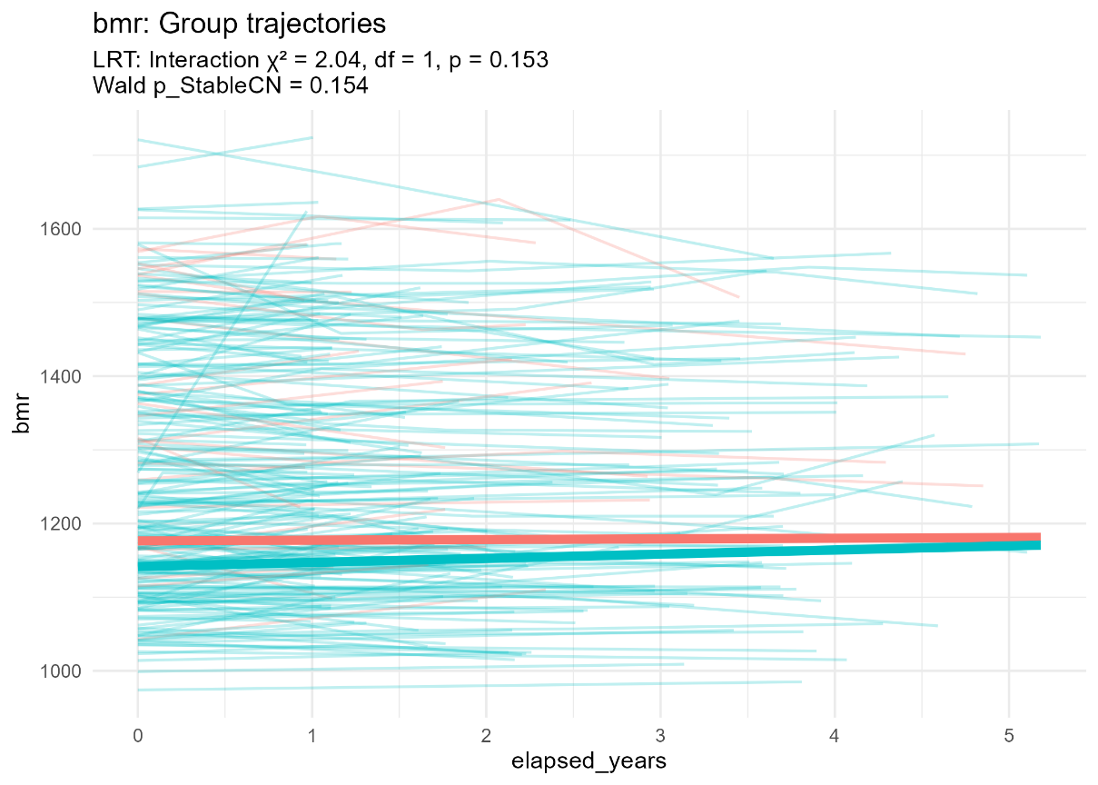
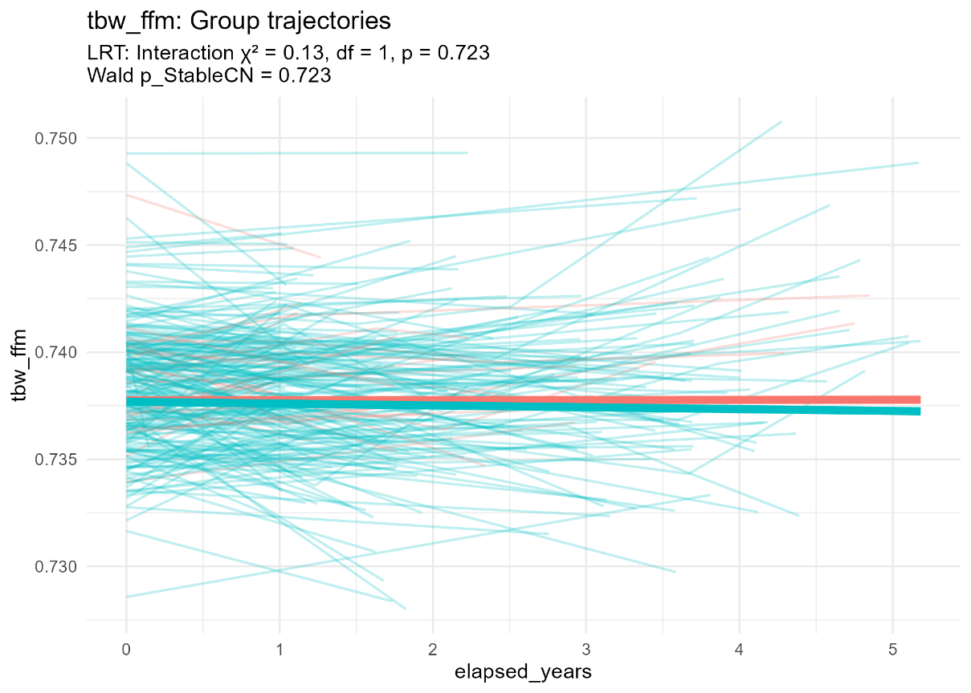
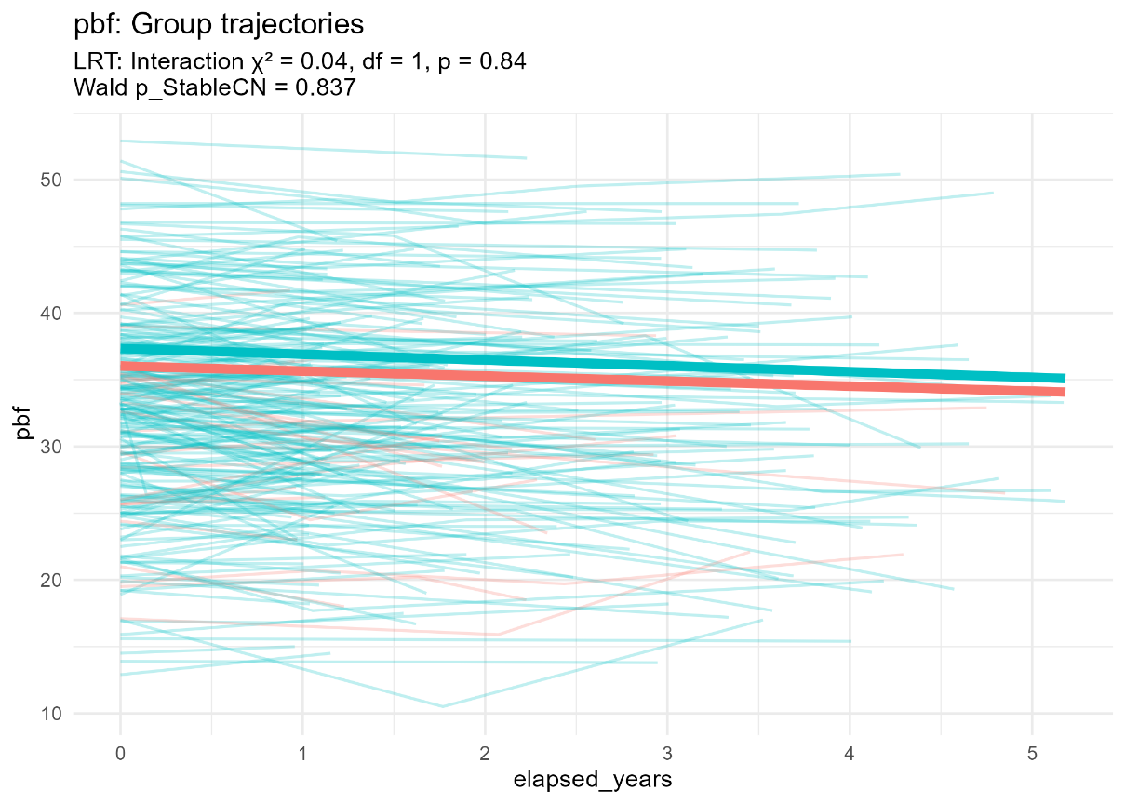
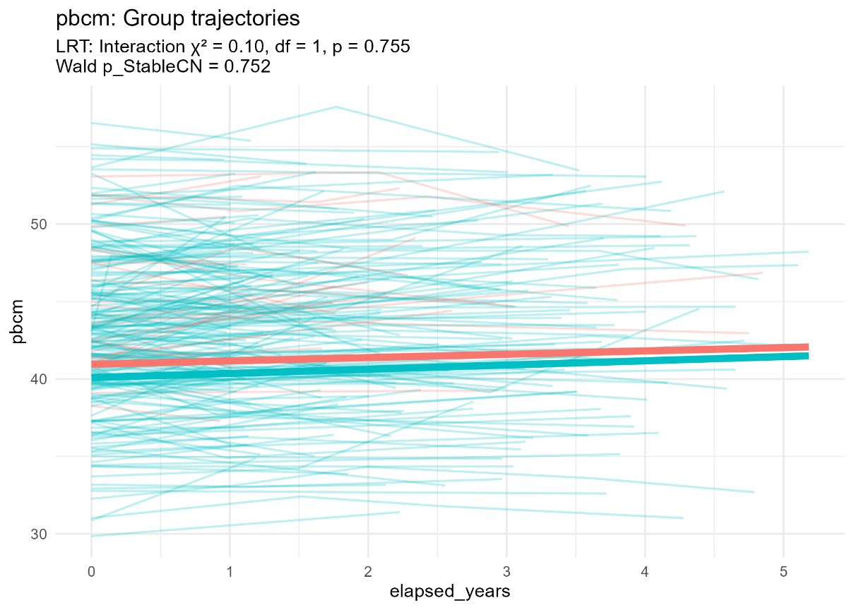
Linear Mixed-Effects Modeling

Slide 10
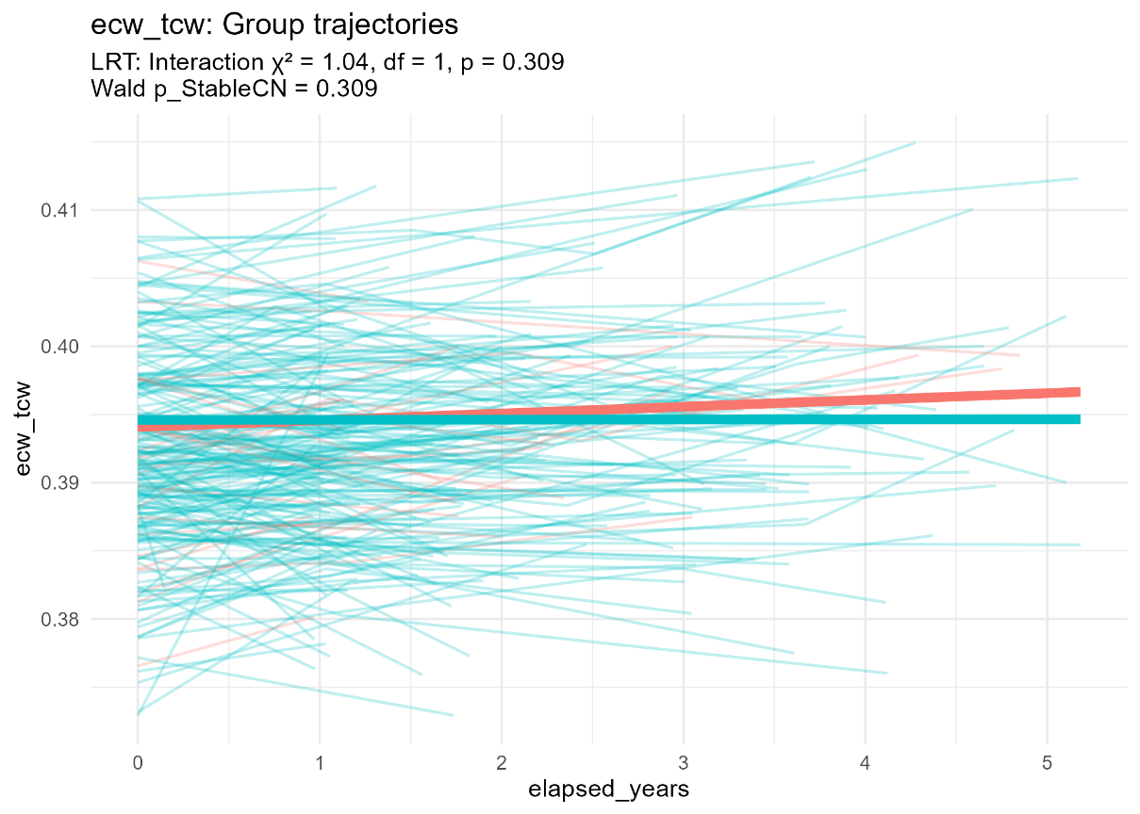
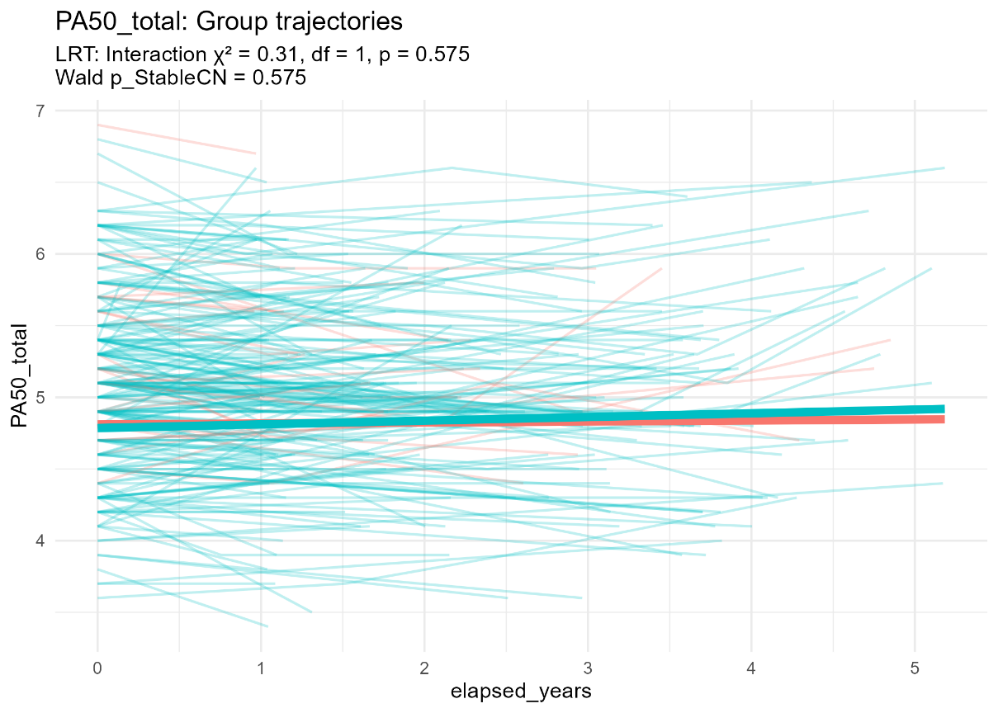
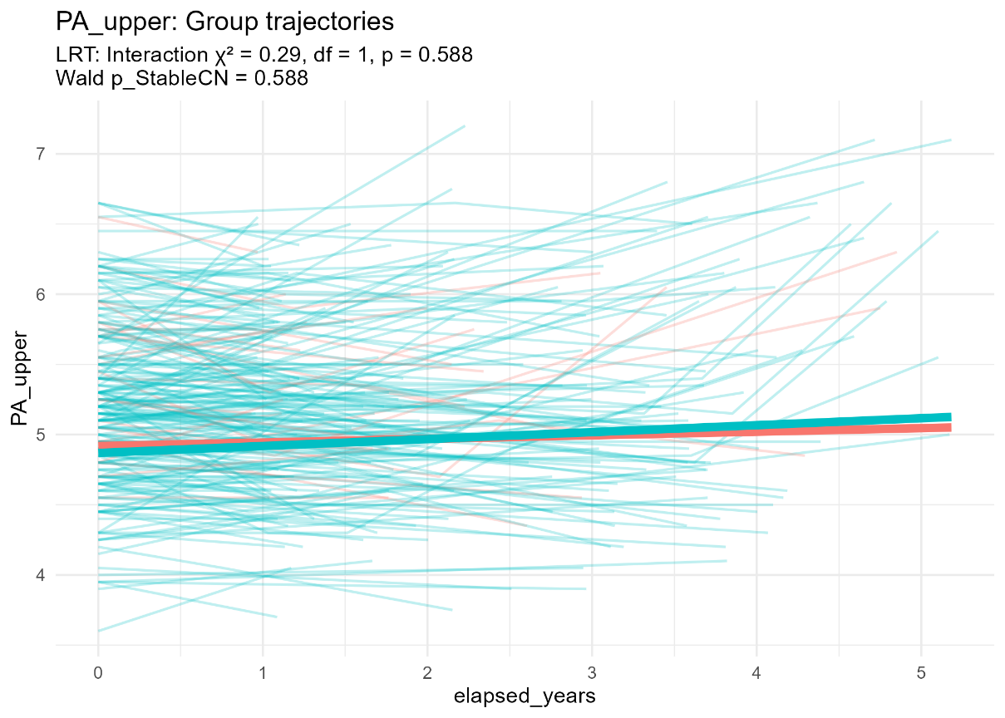
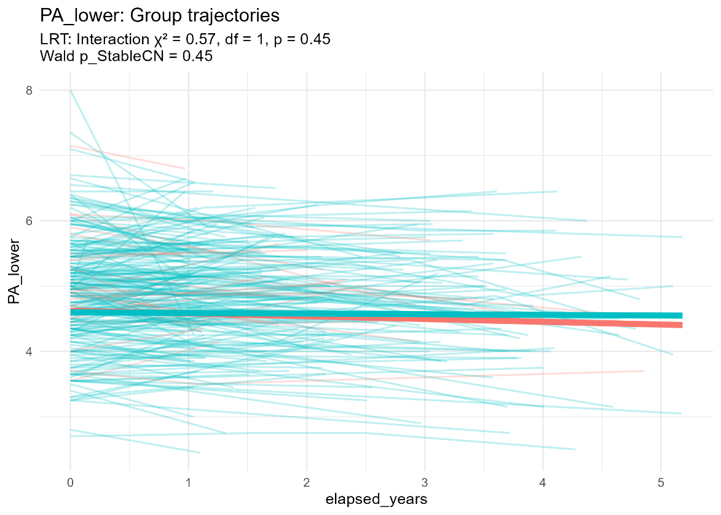
Linear Mixed-Effects Modeling

Slide 11
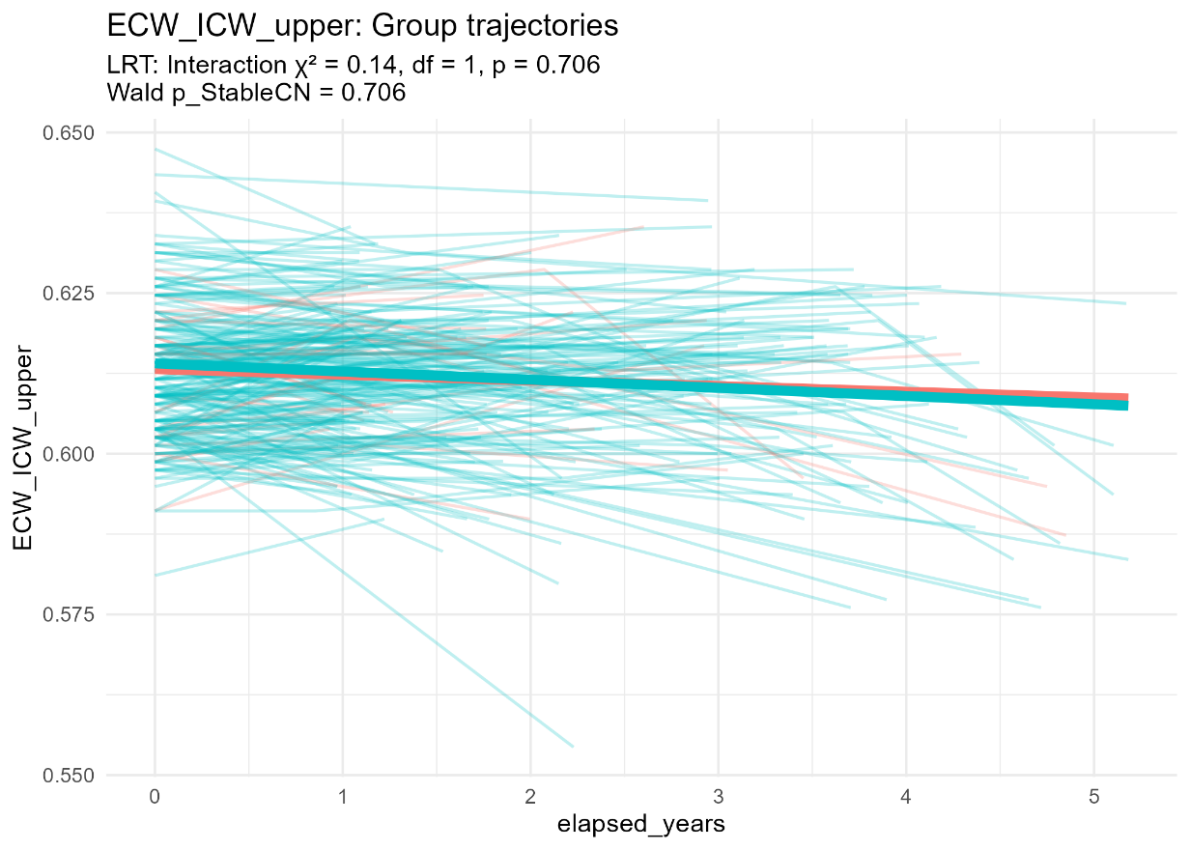
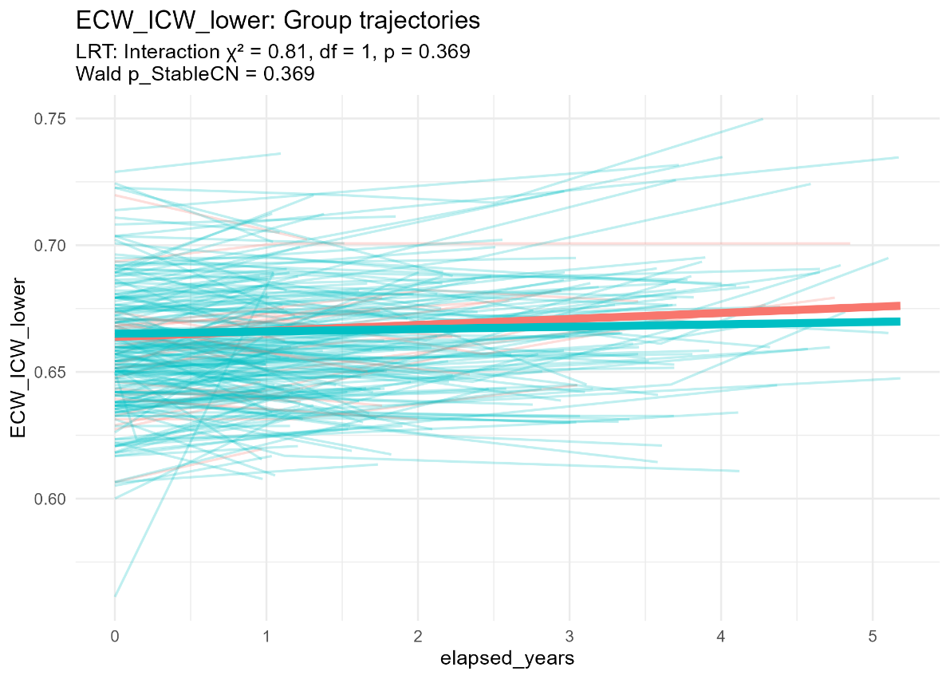
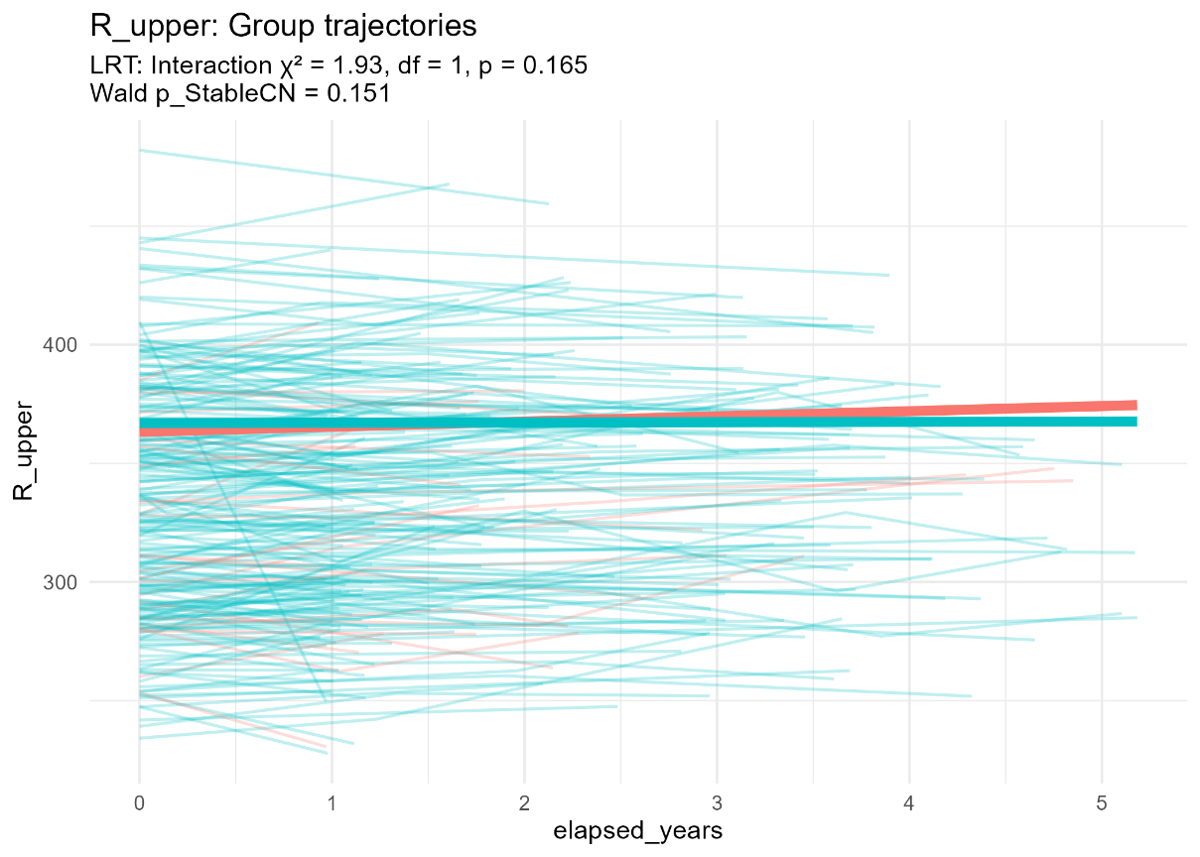
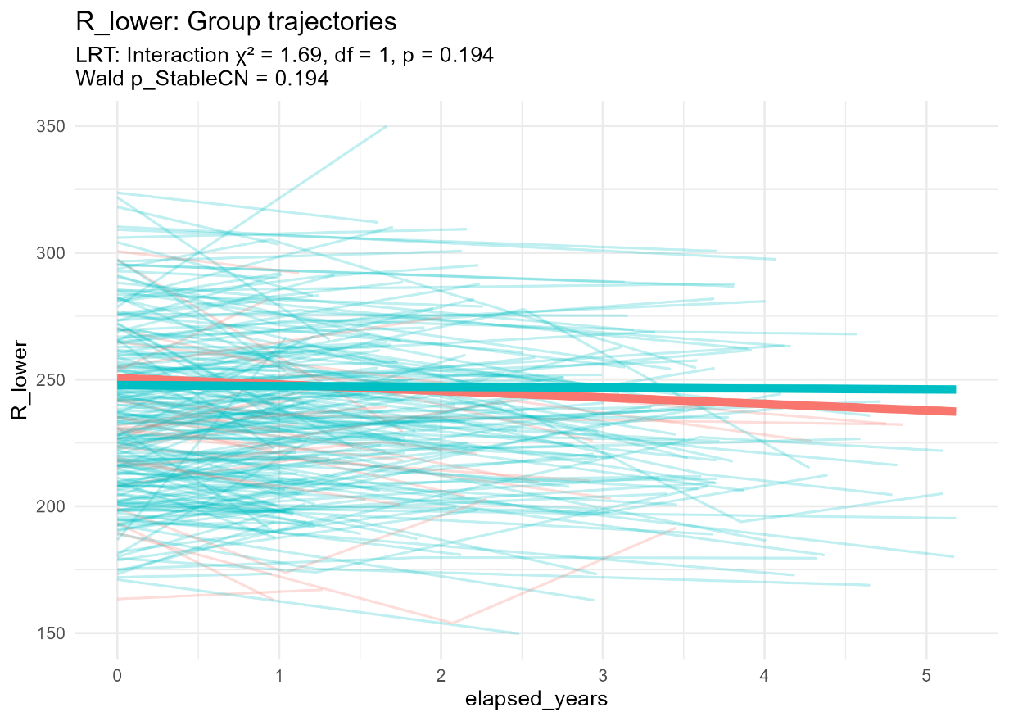
Linear Mixed-Effects Modeling

Slide 12
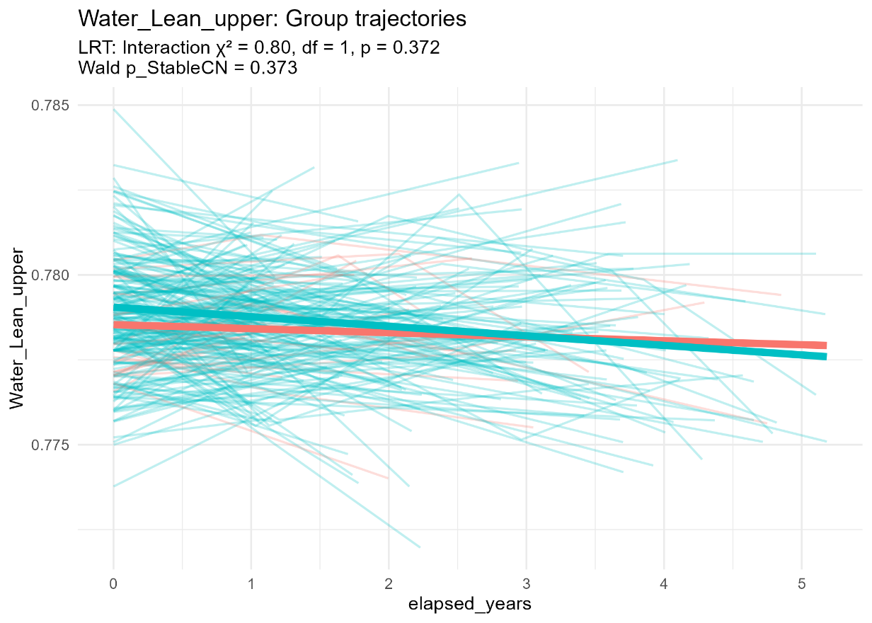
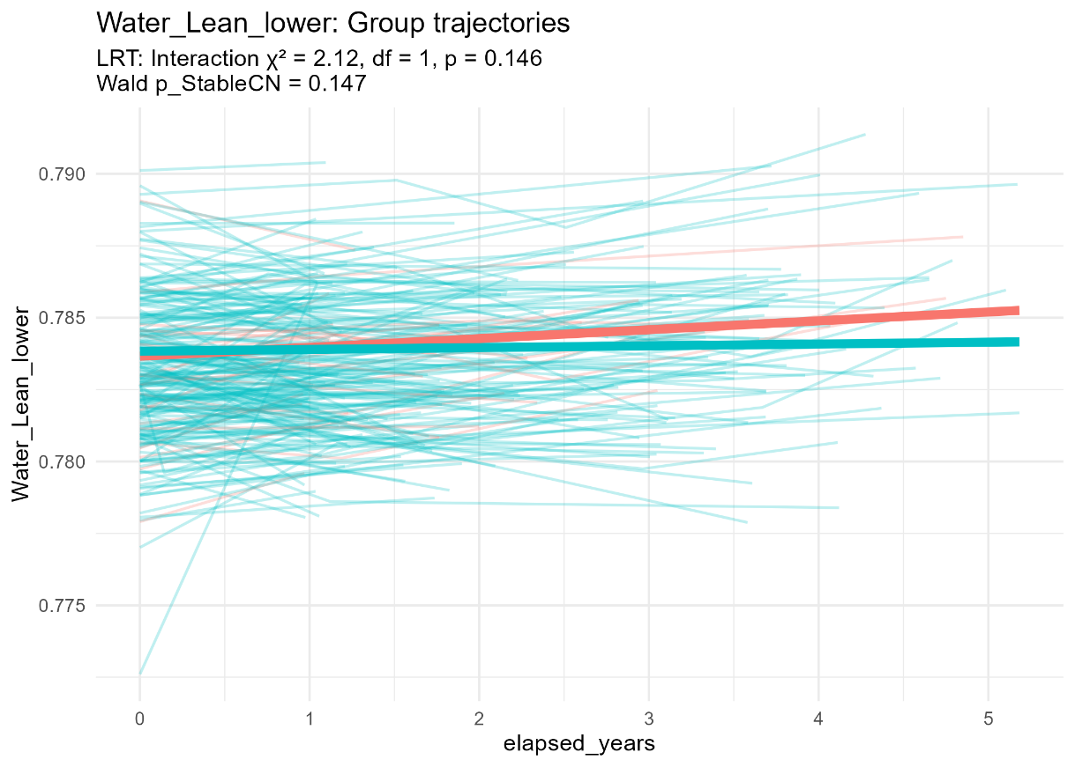
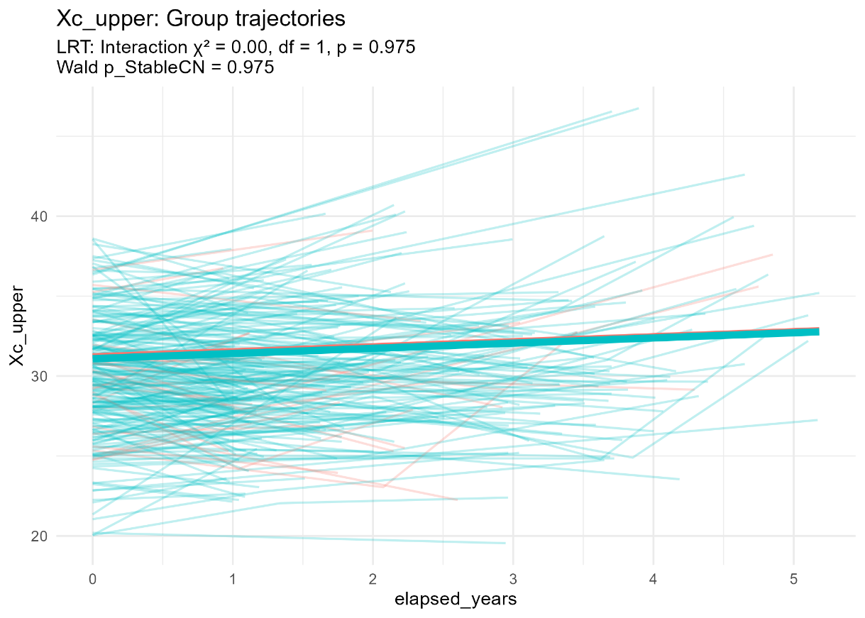
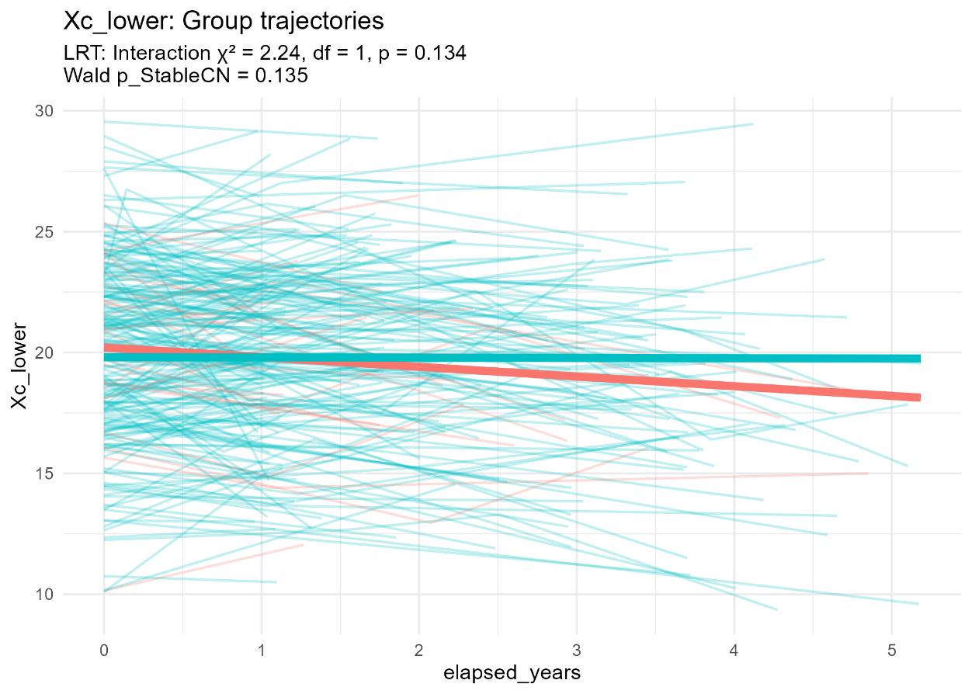
Linear Mixed-Effects Modeling

Slide 13
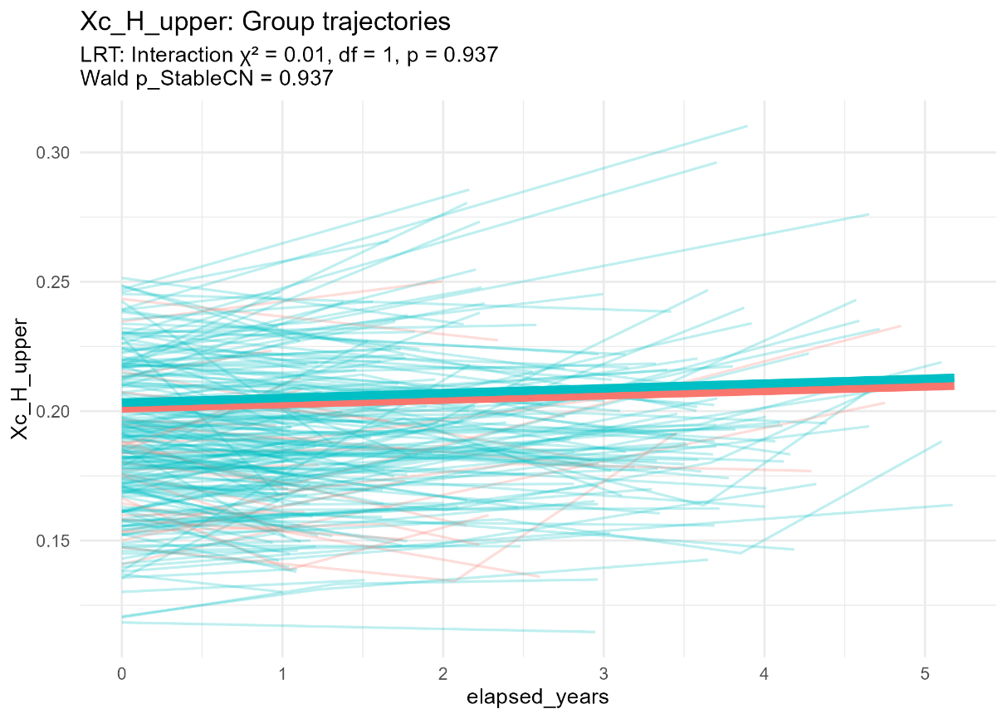
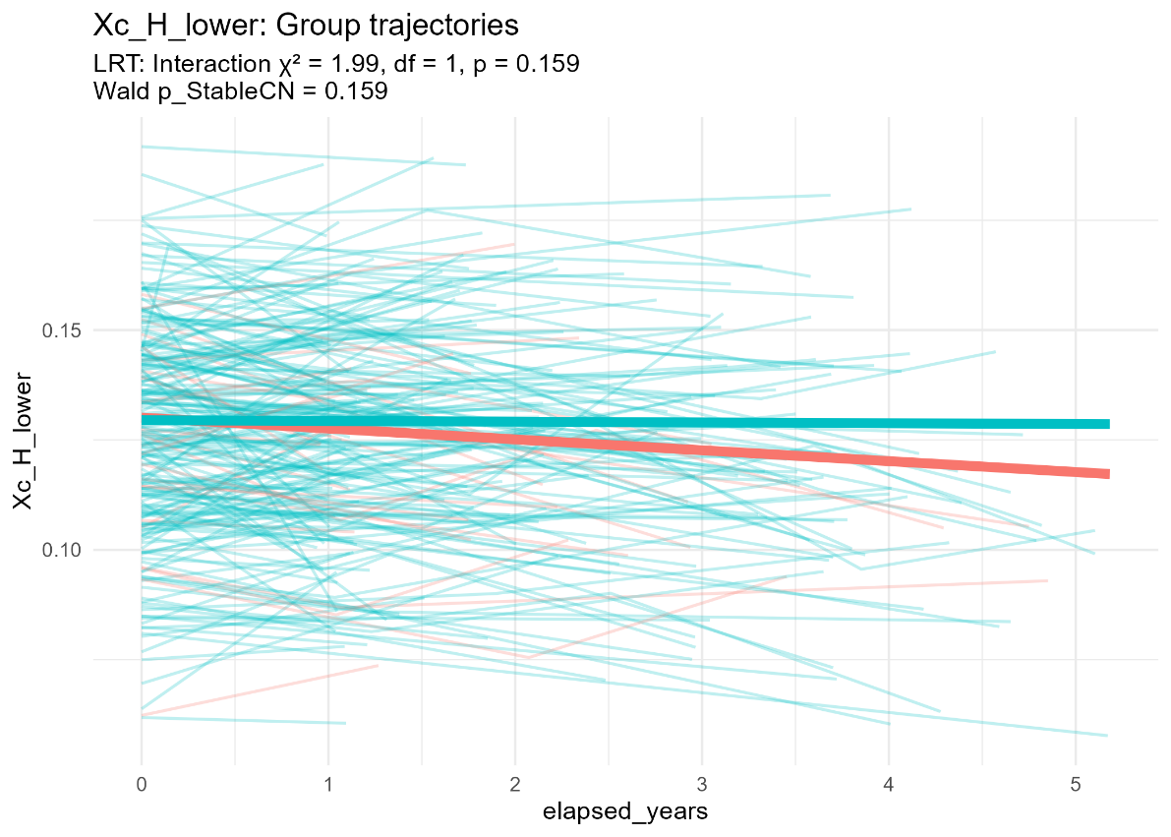
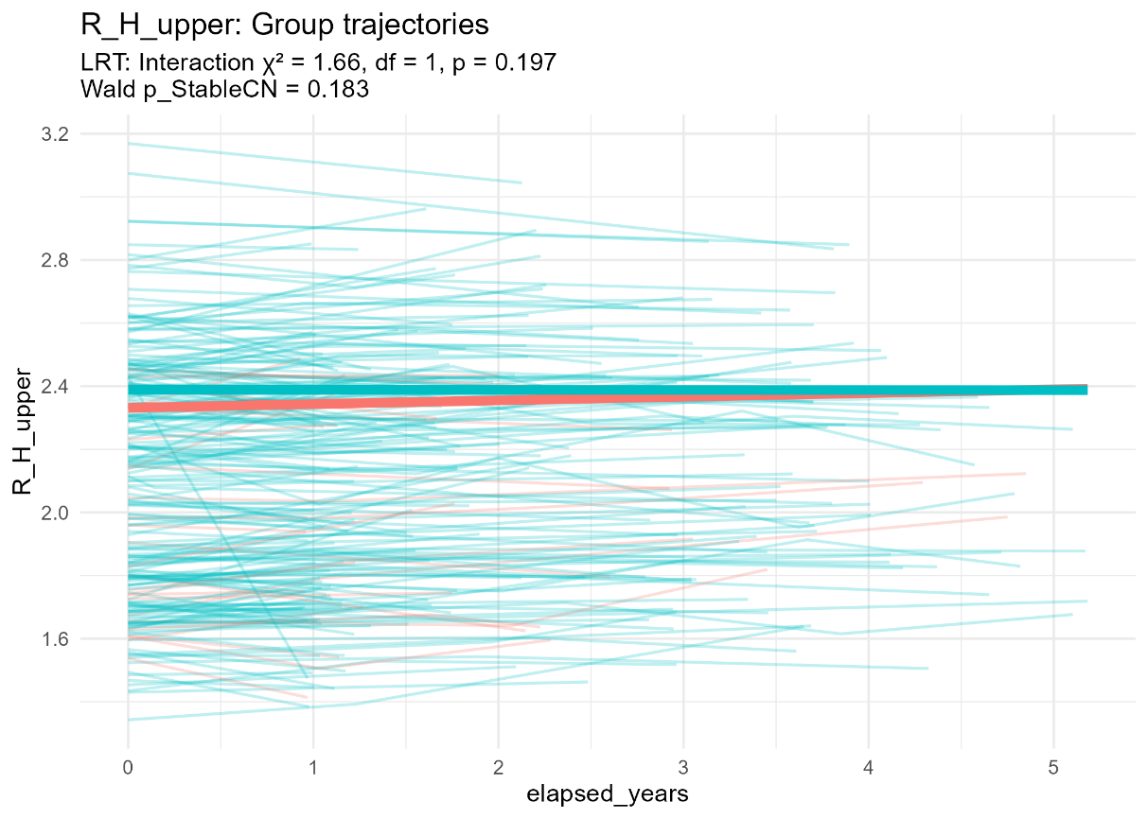
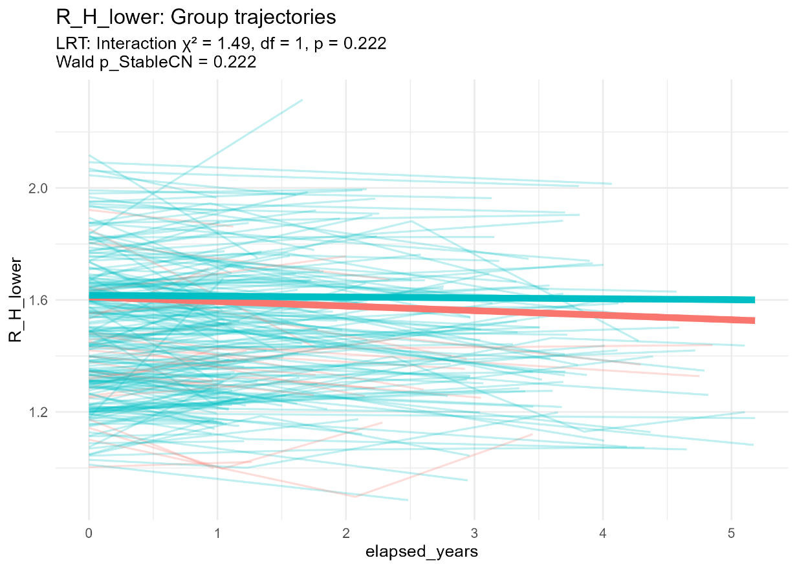
Linear Mixed-Effects Modeling

Slide 14
Biomarker | StableCN Slope/yr | CNtransitMCI Slope/yr | Slope Diff (95% CI) | LRT p-value* | Wald p-value | Cohen's d
Visuospatial | 0.072 | -0.201 | 0.273 (0.401, 0.145) | 0.00004 | 0.00003 | 0.81
Language | 0.017 | -0.030 | 0.047 (0.089, 0.004) | 0.02710 | 0.02712 | 0.25
Whr | -0.002 | -0.008 | 0.006 (0.012, -0.000) | 0.04981 | 0.05012 | 0.23
Xc_lower | -0.012 | -0.401 | 0.389 (0.909, -0.131) | 0.13442 | 0.13527 | 0.21
Water_Lean_lower | 0.000 | 0.000 | -0.000 (0.000, -0.001) | 0.14564 | 0.14678 | 0.19
Bmr | 5.609 | 0.884 | 4.724 (11.404, -1.955) | 0.15335 | 0.15364 | 0.17
Xc_H_lower | -0.000 | -0.002 | 0.002 (0.006, -0.001) | 0.15882 | 0.15942 | 0.20
R_upper | 0.125 | 2.174 | -2.049 (0.825, -4.923) | 0.16527 | 0.15113 | 0.17
R_lower | -0.328 | -2.555 | 2.227 (5.670, -1.216) | 0.19367 | 0.19394 | 0.16
R_H_upper | -0.000 | 0.012 | -0.012 (0.006, -0.030) | 0.19714 | 0.18287 | 0.17
SNSB-frontal | 12.279 | 7.742 | 4.538 (11.727, -2.651) | 0.21048 | 0.21126 | 0.30
R_H_lower | -0.003 | -0.016 | 0.013 (0.035, -0.009) | 0.22173 | 0.22154 | 0.15
SNSB-attention | 0.114 | -0.062 | 0.175 (0.476, -0.125) | 0.24348 | 0.24217 | 0.15
ecw_tcw | 0.000 | 0.000 | -0.001 (0.001, -0.001) | 0.30879 | 0.30884 | 0.14
ECW/ICW_lower | 0.001 | 0.002 | -0.001 (0.002, -0.005) | 0.36872 | 0.36882 | 0.12
Linear Mixed-Effects Modeling
Notes:
Next is the summary table of the top 15 markers by slope per year.

Slide 15
INITIAL CONCLUSION
In our longitudinal LME study, we found that cognitive converters (CNtransitMCI) deteriorate faster in visuospatial ability, language ability and waist-hip ratio, suggesting both cognitive and subtle anthropometric changes might flag early MCI risk. Most other bioimpedance measures remain stable
Notes:
While most bioimpedance markers did not show significant group differences, changes in WHR over follow-up may represent an early, subtle marker of risk for MCI conversion

Slide 16
Next Step
Test on other potential bioimpedance measures.
Test with covariates: SEX + AGE + EDUYR + GDS score.
Research on the two groups: StableMCI and MCItransitCN.
Notes:
I would like to ask for the professor’s opinion on this matter.

Slide 17
THANK YOU FOR YOUR ATTENTION

